Slide 1
Classification: Probabilistic Generative Model

Slide 2
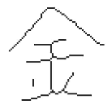

Classification
Function
$$x$$
Class n
Credit Scoring
  Input: income, savings, profession, age, past financial history ……
  Output: accept or refuse
Medical Diagnosis
  Input: current symptoms, age, gender, past medical history ……
  Output: which kind of diseases
Handwritten character recognition
Face recognition
  Input: image of a face, output: person
output:
Input:
金

Slide 3
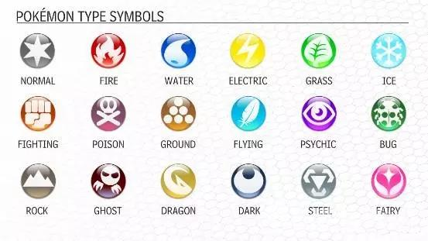









Example Application
$$f\left( \right)=$$
$$f\left( \right)=$$
$$f\left( \right)=$$

Slide 4
Example Application
pokemon games (NOT pokemon cards or Pokemon Go)
HP: hit points, or health, defines how much damage a pokemon can withstand before fainting
Attack: the base modifier for normal attacks (eg. Scratch, Punch)
Defense: the base damage resistance against normal attacks
SP Atk: special attack, the base modifier for special attacks (e.g. fire blast, bubble beam)
SP Def: the base damage resistance against special attacks
Speed: determines which pokemon attacks first each round
35
55
40
50
50
90
Can we predict the “type” of pokemon based on the information?
Notes:
Total 7 features
320,35,55,40,50,50,90

Slide 5
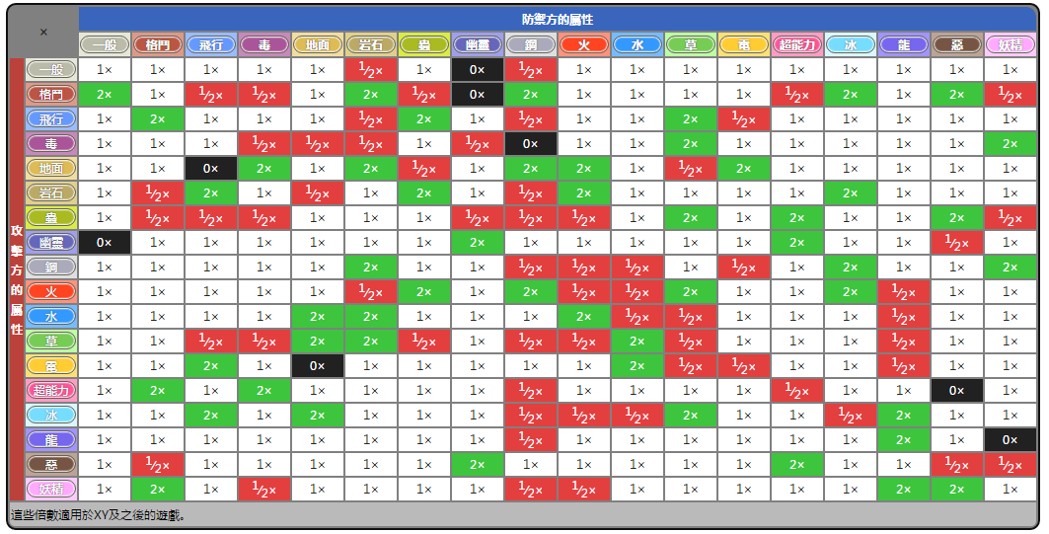
Example Application
Notes:
Predict the type that you have never seen before

Slide 6


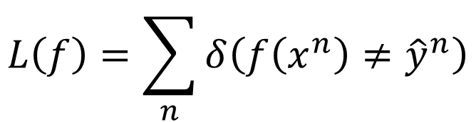


Ideal Alternatives
$$f\left(x\right)$$
Function (Model):
Loss function:
Find the best function:
  Example: Perceptron, SVM
$$g\left(x\right)>0$$
Output = class 1
$$x$$
$$else$$
Output = class 2
$$L\left(f\right)=\sum_{n}{δ\left(f\left(x^{n}\right)≠{\hat{y}}^{n}\right)}$$
The number of times f get incorrect results on training data.
Not Today

Slide 7




How to do Classification
Training data for Classification
$$\left(x^{1},{\hat{y}}^{1}\right)$$
$$\left(x^{2},{\hat{y}}^{2}\right)$$
$$……$$
$$\left(x^{N},{\hat{y}}^{N}\right)$$
Classification as Regression?
Binary classification as example
Training: Class 1 means the target is 1; Class 2 means the target is -1
Testing: closer to 1 $→$ class 1; closer to -1 $→$ class 2

Slide 8
b + w₁x₁ + w₂x₂ = 0
to decrease error
Class 2
Class 2
-1
-1
Multiple class: Class 1 means the target is 1; Class 2 means the target is 2; Class 3 means the target is 3 …… problematic
1
1
x₂
x₂
Class 1
Class 1
>>1
y = b + w₁x₁ + w₂x₂
error
x₁
x₁
Penalize to the examples that are “too correct” …
(Bishop, P186)
Notes:
-0.142857142857 0.285714285714

Slide 9
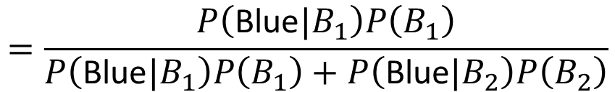
Two Boxes
Box 1
Box 2
P(B₁) = 2/3
P(B₂) = 1/3
P(Blue|B₁) = 4/5
P(Blue|B₁) = 2/5
P(Green|B₁) = 1/5
P(Green|B₁) = 3/5
from one of the boxes
Where does it come from?
$$=\frac{P\left(\text{Blue}|B_{1}\right)P\left(B_{1}\right)}{P\left(\text{Blue}|B_{1}\right)P\left(B_{1}\right)+P\left(\text{Blue}|B_{2}\right)P\left(B_{2}\right)}$$
P(B₁ | Blue)

Slide 10
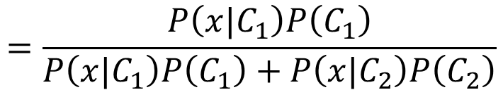



Two Classes
Estimating the Probabilities
From training data
Class 1
Class 2
P(C₁)
P(C₂)
P(x|C₁)
P(x|C₂)
Given an x, which class does it belong to
$$=\frac{P\left(x|C_{1}\right)P\left(C_{1}\right)}{P\left(x|C_{1}\right)P\left(C_{1}\right)+P\left(x|C_{2}\right)P\left(C_{2}\right)}$$
$$P\left(C_{1}|x\right)$$
Generative Model
$$P\left(x\right)$$
$$=P\left(x|C_{1}\right)P\left(C_{1}\right)+P\left(x|C_{2}\right)P\left(C_{2}\right)$$
Notes:
Outlier detection

Slide 11
Prior
Class 1
Class 2
P(C₁)
P(C₂)
Water
Normal
Water and Normal type with ID < 400 for training, rest for testing
  Training: 79 Water, 61 Normal
P(C₁) = 79 / (79 + 61) =0.56
P(C₂) = 61 / (79 + 61) =0.44

Slide 12




Probability from Class
P(x|C₁) = ?
P( |Water)
= ?
Each Pokémon is represented as a vector by its attribute.
feature
79 in total
Water
Type
Notes:
Tirtouga

Slide 13
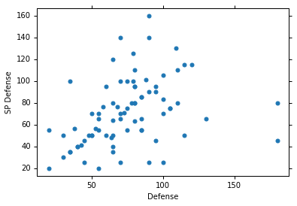
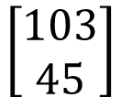


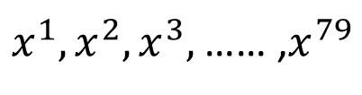
Probability from Class - Feature
Considering Defense and SP Defense
$$\left[\begin{aligned}48 \\ 50\end{aligned}\right]$$
$x^{1},x^{2},x^{3},$ …… ,$x^{79}$
$$\left[\begin{aligned}65 \\ 64\end{aligned}\right]$$
P(x|Water)=?
0?
Assume the points are sampled from a Gaussian distribution.
$$\left[\begin{aligned}103 \\ 45\end{aligned}\right]$$
Water
Type

Slide 14
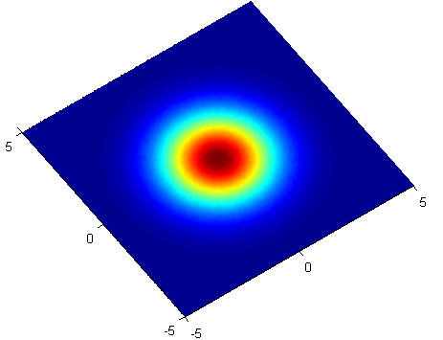
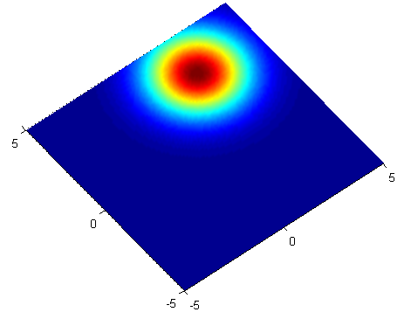





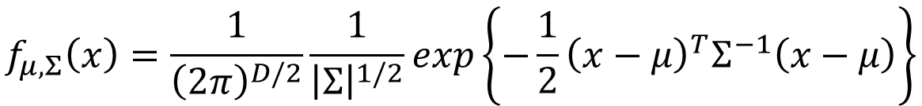

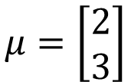
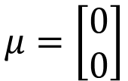

Gaussian Distribution
https://blog.slinuxer.com/tag/pca
$$f_{μ,Σ}\left(x\right)=\frac{1}{{\left(2π\right)}^{D/2}}\frac{1}{{\left|Σ\right|}^{1/2}}exp\left\{−\frac{1}{2}{\left(x−μ\right)}^{T}Σ^{−1}\left(x−μ\right)\right\}$$
Input: vector x, output: probability of sampling x
The shape of the function determines by mean $μ$ and covariance matrix $Σ$
$$μ=\left[\begin{aligned}0 \\ 0\end{aligned}\right]$$
$$\sum{=}\left[\begin{matrix}2 & 0 \\ 0 & 2\end{matrix}\right]$$
$$μ=\left[\begin{aligned}2 \\ 3\end{aligned}\right]$$
$$\sum{=}\left[\begin{matrix}2 & 0 \\ 0 & 2\end{matrix}\right]$$
$$x_{2}$$
$$x_{2}$$
$$x_{1}$$
$$x_{1}$$

Slide 15
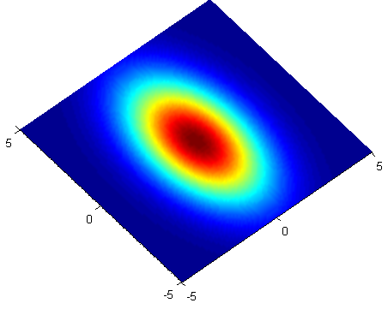
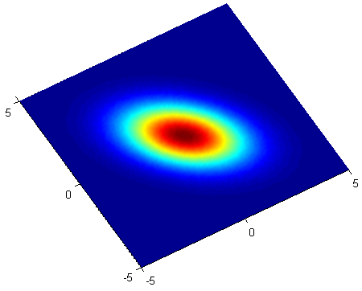

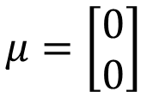
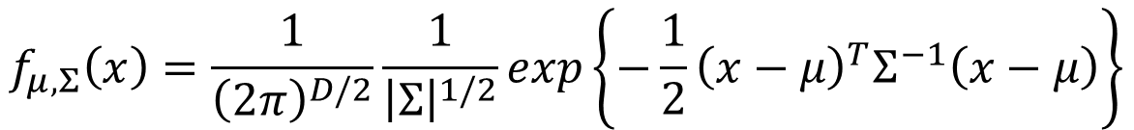

Gaussian Distribution
https://blog.slinuxer.com/tag/pca
$$f_{μ,Σ}\left(x\right)=\frac{1}{{\left(2π\right)}^{D/2}}\frac{1}{{\left|Σ\right|}^{1/2}}exp\left\{−\frac{1}{2}{\left(x−μ\right)}^{T}Σ^{−1}\left(x−μ\right)\right\}$$
Input: vector x, output: probability of sampling x
The shape of the function determines by mean $μ$ and covariance matrix $Σ$
$$μ=\left[\begin{aligned}0 \\ 0\end{aligned}\right]$$
$$\sum{=}\left[\begin{matrix}2 & 0 \\ 0 & 6\end{matrix}\right]$$
$$μ=\left[\begin{aligned}0 \\ 0\end{aligned}\right]$$
$$\sum{=}\left[\begin{matrix}2 & −1 \\ −1 & 2\end{matrix}\right]$$
$$x_{2}$$
$$x_{2}$$
$$x_{1}$$
$$x_{1}$$
Notes:
Ref: https://www.cs.cmu.edu/~epxing/Class/10701-08s/recitation/gaussian.pdf

Slide 16

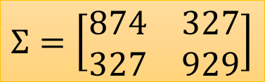

Probability from Class
Assume the points are sampled from a Gaussian distribution
Find the Gaussian distribution behind them
Probability for new points
$x^{1},x^{2},x^{3},$ …… ,$x^{79}$
New x
$$μ=\left[\begin{aligned}75.0 \\ 71.3\end{aligned}\right]$$
$$Σ=\left[\begin{matrix}874 & 327 \\ 327 & 929\end{matrix}\right]$$
How to find them?
Water
Type
$$f_{μ,Σ}\left(x\right)=\frac{1}{{\left(2π\right)}^{D/2}}\frac{1}{{\left|Σ\right|}^{1/2}}exp\left\{−\frac{1}{2}{\left(x−μ\right)}^{T}Σ^{−1}\left(x−μ\right)\right\}$$

Slide 17
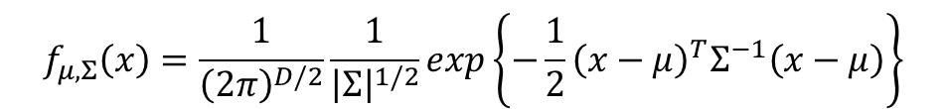

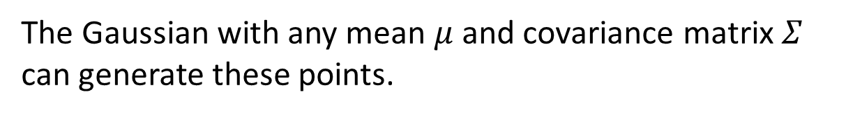
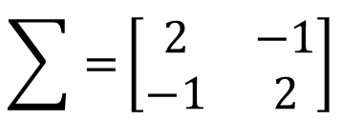
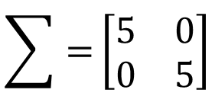
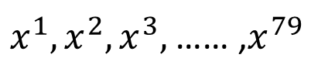
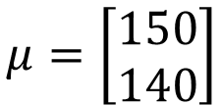
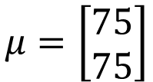
Maximum Likelihood
$$f_{μ,Σ}\left(x\right)=\frac{1}{{\left(2π\right)}^{D/2}}\frac{1}{{\left|Σ\right|}^{1/2}}exp\left\{−\frac{1}{2}{\left(x−μ\right)}^{T}Σ^{−1}\left(x−μ\right)\right\}$$
$$\sum{=}\left[\begin{matrix}5 & 0 \\ 0 & 5\end{matrix}\right]$$
$x^{1},x^{2},x^{3},$ …… ,$x^{79}$
$$μ=\left[\begin{aligned}150 \\ 140\end{aligned}\right]$$
$$\sum{=}\left[\begin{matrix}2 & −1 \\ −1 & 2\end{matrix}\right]$$
$$μ=\left[\begin{aligned}75 \\ 75\end{aligned}\right]$$
The Gaussian with any mean $μ$ and covariance matrix $Σ$ can generate these points.
Different Likelihood
Likelihood of a Gaussian with mean $μ$ and covariance matrix $Σ$
= the probability of the Gaussian samples $x^{1},x^{2},x^{3},$ …… ,$x^{79}$
$$L\left(μ,Σ\right)$$
$$=f_{μ,Σ}\left(x^{1}\right)f_{μ,Σ}\left(x^{2}\right)f_{μ,Σ}\left(x^{3}\right)……f_{μ,Σ}\left(x^{79}\right)$$

Slide 18
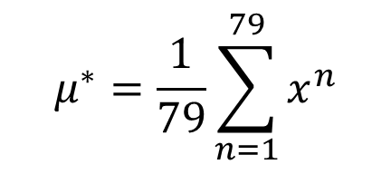
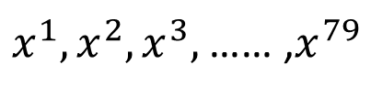
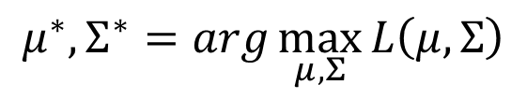
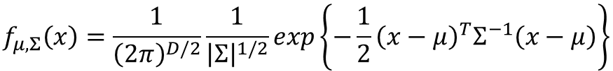

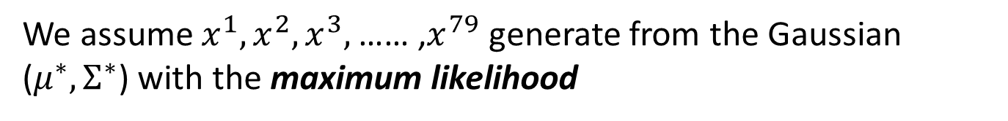
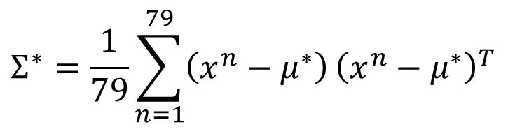
Maximum Likelihood
We have the “Water” type Pokémons:
$x^{1},x^{2},x^{3},$ …… ,$x^{79}$
We assume $x^{1},x^{2},x^{3},$ …… ,$x^{79}$ generate from the Gaussian ($μ^{∗},Σ^{∗}$) with the maximum likelihood
$$L\left(μ,Σ\right)$$
$$=f_{μ,Σ}\left(x^{1}\right)f_{μ,Σ}\left(x^{2}\right)f_{μ,Σ}\left(x^{3}\right)……f_{μ,Σ}\left(x^{79}\right)$$
$$f_{μ,Σ}\left(x\right)=\frac{1}{{\left(2π\right)}^{D/2}}\frac{1}{{\left|Σ\right|}^{1/2}}exp\left\{−\frac{1}{2}{\left(x−μ\right)}^{T}Σ^{−1}\left(x−μ\right)\right\}$$
$$μ^{∗},Σ^{∗}=arg\max_{μ,Σ}{L\left(μ,Σ\right)}$$
$$μ^{∗}=\frac{1}{79}\sum_{n=1}^{79}{x^{n}}$$
$$Σ^{∗}=\frac{1}{79}\sum_{n=1}^{79}{\left(x^{n}−μ^{∗}\right)}{\left(x^{n}−μ^{∗}\right)}^{T}$$
average

Slide 19
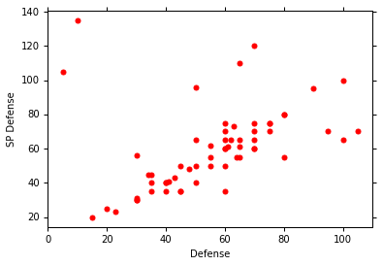
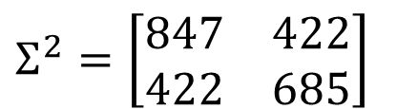
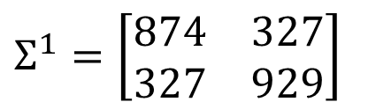
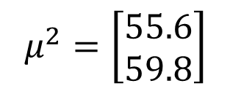
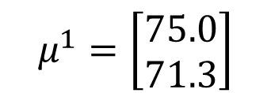
Maximum Likelihood
Class 1: Water
Class 2: Normal
$$μ^{1}=\left[\begin{aligned}75.0 \\ 71.3\end{aligned}\right]$$
$$Σ^{1}=\left[\begin{matrix}874 & 327 \\ 327 & 929\end{matrix}\right]$$
$$μ^{2}=\left[\begin{aligned}55.6 \\ 59.8\end{aligned}\right]$$
$$Σ^{2}=\left[\begin{matrix}847 & 422 \\ 422 & 685\end{matrix}\right]$$
Notes:
[[ 873.85931742 327.20269188] [ 327.20269188 928.67649415]]
[[ 847.77317895 421.65495494] [ 421.65495494 684.78459736]]

Slide 20

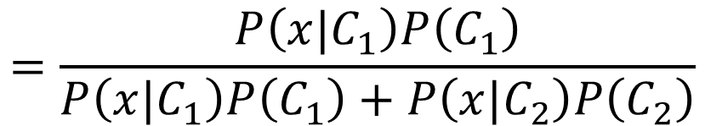

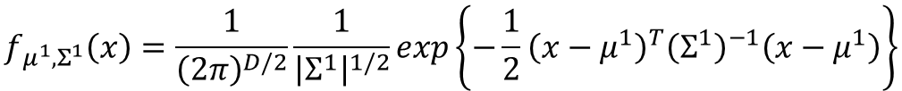
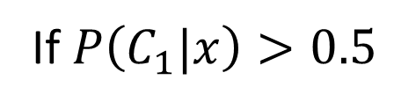



Now we can do classification ☺
$$f_{μ^{1},Σ^{1}}\left(x\right)=\frac{1}{{\left(2π\right)}^{D/2}}\frac{1}{{\left|Σ^{1}\right|}^{1/2}}exp\left\{−\frac{1}{2}{\left(x−μ^{1}\right)}^{T}{\left(Σ^{1}\right)}^{−1}\left(x−μ^{1}\right)\right\}$$
P(C1)
= 79 / (79 + 61) =0.56
$$μ^{1}=\left[\begin{aligned}75.0 \\ 71.3\end{aligned}\right]$$
$$Σ^{1}=\left[\begin{matrix}874 & 327 \\ 327 & 929\end{matrix}\right]$$
$$=\frac{P\left(x|C_{1}\right)P\left(C_{1}\right)}{P\left(x|C_{1}\right)P\left(C_{1}\right)+P\left(x|C_{2}\right)P\left(C_{2}\right)}$$
$$P\left(C_{1}|x\right)$$
$$f_{μ^{2},Σ^{2}}\left(x\right)=\frac{1}{{\left(2π\right)}^{D/2}}\frac{1}{{\left|Σ^{2}\right|}^{1/2}}exp\left\{−\frac{1}{2}{\left(x−μ^{2}\right)}^{T}{\left(Σ^{2}\right)}^{−1}\left(x−μ^{2}\right)\right\}$$
P(C2)
= 61 / (79 + 61)
=0.44
$$μ^{2}=\left[\begin{aligned}55.6 \\ 59.8\end{aligned}\right]$$
$$Σ^{2}=\left[\begin{matrix}847 & 422 \\ 422 & 685\end{matrix}\right]$$
If $P\left(C_{1}|x\right)>0.5$
x belongs to class 1 (Water)

Slide 21
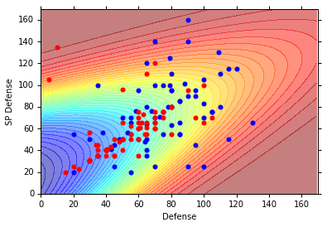
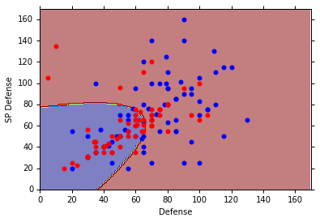
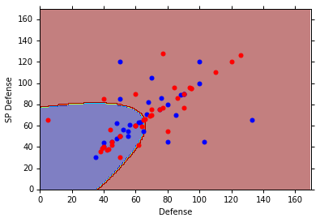





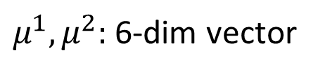

$$P\left(C_{1}|x\right)$$
$$>0.5$$
$$P\left(C_{1}|x\right)$$
$$P\left(C_{1}|x\right)<0.5$$
Blue points: C₁ (Water), Red points: C₂ (Normal)
How’s the results?
$$P\left(C_{1}|x\right)$$
$$>0.5$$
Testing data: 47% accuracy ☹
All: hp, att, sp att,
de, sp de, speed (6 features)
$μ^{1},μ^{2}:$ 6-dim vector
$Σ^{1},Σ^{2}:$ 6 x 6 matrices
$$P\left(C_{1}|x\right)<0.5$$
64% accuracy …

Slide 22
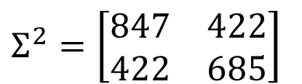




Modifying Model
Class 1: Water
Class 2: Normal
$$μ^{1}=\left[\begin{aligned}75.0 \\ 71.3\end{aligned}\right]$$
$$Σ^{1}=\left[\begin{matrix}874 & 327 \\ 327 & 929\end{matrix}\right]$$
$$μ^{2}=\left[\begin{aligned}55.6 \\ 59.8\end{aligned}\right]$$
$$Σ^{2}=\left[\begin{matrix}847 & 422 \\ 422 & 685\end{matrix}\right]$$
The same $Σ$
Less parameters
Notes:
Do I realy overfit the data

Slide 23








Modifying Model
Ref: Bishop, chapter 4.2.2
Maximum likelihood
“Water” type Pokémons:
“Normal” type Pokémons:
$x^{1},x^{2},x^{3},$ …… ,$x^{79}$
$x^{80},x^{81},x^{82},$ …… ,$x^{140}$
$$μ^{1}$$
$Σ$
$$μ^{2}$$
Find $μ^{1}$, $μ^{2}$, $Σ$ maximizing the likelihood $L\left(μ^{1}\text{,}μ^{2}\text{,}Σ\right)$
$$L\left(μ^{1}\text{,}μ^{2}\text{,}Σ\right)=f_{μ^{1},Σ}\left(x^{1}\right)f_{μ^{1},Σ}\left(x^{2}\right)⋯f_{μ^{1},Σ}\left(x^{79}\right)$$
$$×f_{μ^{2},Σ}\left(x^{80}\right)f_{μ^{2},Σ}\left(x^{81}\right)⋯f_{μ^{2},Σ}\left(x^{140}\right)$$
$μ^{1}$ and $μ^{2}$ is the same
$Σ=\frac{79}{140}Σ^{1}+\frac{61}{140}Σ^{2}$

Slide 24

Modifying Model
The boundary is linear
The same covariance matrix
All: hp, att, sp att, de, sp de, speed
54% accuracy
73% accuracy
Notes:
Indenty: 50% accuracy
Share diagonal
: 56%
Indenty: 54%
Not Shared diagonal

Slide 25




Three Steps
Function Set (Model):
Goodness of a function:
  The mean $μ$ and covariance $Σ$ that maximizing the likelihood (the probability of generating data)
Find the best function: easy
$$P\left(C_{1}|x\right)=\frac{P\left(x|C_{1}\right)P\left(C_{1}\right)}{P\left(x|C_{1}\right)P\left(C_{1}\right)+P\left(x|C_{2}\right)P\left(C_{2}\right)}$$
$$x$$
If $P\left(C_{1}|x\right)>0.5$, output: class 1
Otherwise, output: class 2

Slide 26





Probability Distribution
You can always use the distribution you like ☺
$$P\left(x|C_{1}\right)$$
$$=P\left(x_{1}|C_{1}\right)$$
$$P\left(x_{2}|C_{1}\right)$$
……
$$P\left(x_{k}|C_{1}\right)$$
……
$$\left[\begin{aligned}x_{1} \\ x_{2} \\ ⋮ \\ x_{k} \\ ⋮ \\ x_{K}\end{aligned}\right]$$
1-D Gaussian
For binary features, you may assume they are from Bernoulli distributions.
If you assume all the dimensions are independent, then you are using Naive Bayes Classifier.

Slide 27






Posterior Probability
$$P\left(C_{1}|x\right)=\frac{P\left(x|C_{1}\right)P\left(C_{1}\right)}{P\left(x|C_{1}\right)P\left(C_{1}\right)+P\left(x|C_{2}\right)P\left(C_{2}\right)}$$
$$=\frac{1}{1+\frac{P\left(x|C_{2}\right)P\left(C_{2}\right)}{P\left(x|C_{1}\right)P\left(C_{1}\right)}}$$
$$=\frac{1}{1+exp\left(−z\right)}$$
$$=σ\left(z\right)$$
Sigmoid function
$$z=ln\frac{P\left(x|C_{1}\right)P\left(C_{1}\right)}{P\left(x|C_{2}\right)P\left(C_{2}\right)}$$

Slide 28
Warning of Math

Slide 29








Posterior Probability
$$z=ln\frac{P\left(x|C_{1}\right)P\left(C_{1}\right)}{P\left(x|C_{2}\right)P\left(C_{2}\right)}$$
$$P\left(C_{1}|x\right)$$
$$=σ\left(z\right)$$
sigmoid
$$\frac{\frac{N_{1}}{N_{1}+N_{2}}}{\frac{N_{2}}{N_{1}+N_{2}}}$$
$$z=ln\frac{P\left(x|C_{1}\right)}{P\left(x|C_{2}\right)}+ln\frac{P\left(C_{1}\right)}{P\left(C_{2}\right)}$$
$$=\frac{N_{1}}{N_{2}}$$
$$P\left(x|C_{1}\right)=\frac{1}{{\left(2π\right)}^{D/2}}\frac{1}{{\left|Σ^{1}\right|}^{1/2}}exp\left\{−\frac{1}{2}{\left(x−μ^{1}\right)}^{T}{\left(Σ^{1}\right)}^{−1}\left(x−μ^{1}\right)\right\}$$
$$P\left(x|C_{2}\right)=\frac{1}{{\left(2π\right)}^{D/2}}\frac{1}{{\left|Σ^{2}\right|}^{1/2}}exp\left\{−\frac{1}{2}{\left(x−μ^{2}\right)}^{T}{\left(Σ^{2}\right)}^{−1}\left(x−μ^{2}\right)\right\}$$

Slide 30






$$z=ln\frac{P\left(x|C_{1}\right)}{P\left(x|C_{2}\right)}+ln\frac{P\left(C_{1}\right)}{P\left(C_{2}\right)}$$
$$=\frac{N_{1}}{N_{2}}$$
$$P\left(x|C_{1}\right)=\frac{1}{{\left(2π\right)}^{D/2}}\frac{1}{{\left|Σ^{1}\right|}^{1/2}}exp\left\{−\frac{1}{2}{\left(x−μ^{1}\right)}^{T}{\left(Σ^{1}\right)}^{−1}\left(x−μ^{1}\right)\right\}$$
$$P\left(x|C_{2}\right)=\frac{1}{{\left(2π\right)}^{D/2}}\frac{1}{{\left|Σ^{2}\right|}^{1/2}}exp\left\{−\frac{1}{2}{\left(x−μ^{2}\right)}^{T}{\left(Σ^{2}\right)}^{−1}\left(x−μ^{2}\right)\right\}$$
$$ln\frac{\frac{1}{{\left(2π\right)}^{D/2}}\frac{1}{{\left|Σ^{1}\right|}^{1/2}}exp\left\{−\frac{1}{2}{\left(x−μ^{1}\right)}^{T}{\left(Σ^{1}\right)}^{−1}\left(x−μ^{1}\right)\right\}}{\frac{1}{{\left(2π\right)}^{D/2}}\frac{1}{{\left|Σ^{2}\right|}^{1/2}}exp\left\{−\frac{1}{2}{\left(x−μ^{2}\right)}^{T}{\left(Σ^{2}\right)}^{−1}\left(x−μ^{2}\right)\right\}}$$
$$=ln\frac{{\left|Σ^{2}\right|}^{1/2}}{{\left|Σ^{1}\right|}^{1/2}}exp\left\{−\frac{1}{2}\left[{\left(x−μ^{1}\right)}^{T}{\left(Σ^{1}\right)}^{−1}\left(x−μ^{1}\right)−{\left(x−μ^{2}\right)}^{T}{\left(Σ^{2}\right)}^{−1}\left(x−μ^{2}\right)\right]\right\}$$
$$=ln\frac{{\left|Σ^{2}\right|}^{1/2}}{{\left|Σ^{1}\right|}^{1/2}}−\frac{1}{2}\left[{\left(x−μ^{1}\right)}^{T}{\left(Σ^{1}\right)}^{−1}\left(x−μ^{1}\right)−{\left(x−μ^{2}\right)}^{T}{\left(Σ^{2}\right)}^{−1}\left(x−μ^{2}\right)\right]$$

Slide 31






$$z=ln\frac{P\left(x|C_{1}\right)}{P\left(x|C_{2}\right)}+ln\frac{P\left(C_{1}\right)}{P\left(C_{2}\right)}$$
$$=\frac{N_{1}}{N_{2}}$$
$$=ln\frac{{\left|Σ^{2}\right|}^{1/2}}{{\left|Σ^{1}\right|}^{1/2}}−\frac{1}{2}\left[{\left(x−μ^{1}\right)}^{T}{\left(Σ^{1}\right)}^{−1}\left(x−μ^{1}\right)−{\left(x−μ^{2}\right)}^{T}{\left(Σ^{2}\right)}^{−1}\left(x−μ^{2}\right)\right]$$
$${\left(x−μ^{1}\right)}^{T}{\left(Σ^{1}\right)}^{−1}\left(x−μ^{1}\right)$$
$=x^{T}{\left(Σ^{1}\right)}^{−1}x−x^{T}{\left(Σ^{1}\right)}^{−1}μ^{1}−{\left(μ^{1}\right)}^{T}{\left(Σ^{1}\right)}^{−1}x$ $+{\left(μ^{1}\right)}^{T}{\left(Σ^{1}\right)}^{−1}μ^{1}$
$$=x^{T}{\left(Σ^{1}\right)}^{−1}x−2{\left(μ^{1}\right)}^{T}{\left(Σ^{1}\right)}^{−1}x+{\left(μ^{1}\right)}^{T}{\left(Σ^{1}\right)}^{−1}μ^{1}$$
$${\left(x−μ^{2}\right)}^{T}{\left(Σ^{2}\right)}^{−1}\left(x−μ^{2}\right)$$
$$=x^{T}{\left(Σ^{2}\right)}^{−1}x−2{\left(μ^{2}\right)}^{T}{\left(Σ^{2}\right)}^{−1}x+{\left(μ^{2}\right)}^{T}{\left(Σ^{2}\right)}^{−1}μ^{2}$$
$$z=ln\frac{{\left|Σ^{2}\right|}^{1/2}}{{\left|Σ^{1}\right|}^{1/2}}$$
$$−\frac{1}{2}x^{T}{\left(Σ^{1}\right)}^{−1}x+{\left(μ^{1}\right)}^{T}{\left(Σ^{1}\right)}^{−1}x−\frac{1}{2}{\left(μ^{1}\right)}^{T}{\left(Σ^{1}\right)}^{−1}μ^{1}$$
$$+\frac{1}{2}x^{T}{\left(Σ^{2}\right)}^{−1}x−{\left(μ^{2}\right)}^{T}{\left(Σ^{2}\right)}^{−1}x+\frac{1}{2}{\left(μ^{2}\right)}^{T}{\left(Σ^{2}\right)}^{−1}μ^{2}$$
$$+ln\frac{N_{1}}{N_{2}}$$

Slide 32
End of Warning

Slide 33










$$P\left(C_{1}|x\right)$$
$$=σ\left(z\right)$$
$$z=ln\frac{{\left|Σ^{2}\right|}^{1/2}}{{\left|Σ^{1}\right|}^{1/2}}$$
$$−\frac{1}{2}x^{T}{\left(Σ^{1}\right)}^{−1}x+{\left(μ^{1}\right)}^{T}{\left(Σ^{1}\right)}^{−1}x−\frac{1}{2}{\left(μ^{1}\right)}^{T}{\left(Σ^{1}\right)}^{−1}μ^{1}$$
$$+\frac{1}{2}x^{T}{\left(Σ^{2}\right)}^{−1}x−{\left(μ^{2}\right)}^{T}{\left(Σ^{2}\right)}^{−1}x+\frac{1}{2}{\left(μ^{2}\right)}^{T}{\left(Σ^{2}\right)}^{−1}μ^{2}$$
$$+ln\frac{N_{1}}{N_{2}}$$
$$Σ_{1}=Σ_{2}=Σ$$
$$z={\left(μ^{1}−μ^{2}\right)}^{T}Σ^{−1}x−\frac{1}{2}{\left(μ^{1}\right)}^{T}Σ^{−1}μ^{1}+\frac{1}{2}{\left(μ^{2}\right)}^{T}Σ^{−1}μ^{2}+ln\frac{N_{1}}{N_{2}}$$
$$w^{T}$$
$$b$$
$$P\left(C_{1}|x\right)=σ\left(w∙x+b\right)$$
How about directly find w and b?
In generative model, we estimate $N_{1},$ $N_{2}$, $μ^{1}$, $μ^{2}$, $Σ$
Then we have w and b

Slide 34
随堂小回顾

Slide 35

单选题
1分
机器学习的经典定义是：利用（）改善系统的自身性能。
A
专家
B
经验
C
规则
D
实践
提交

Slide 36
单选题
1分
计算学习理论重最重要的理论模型是？
A
计算模型
B
PAC(概率近似正确)
C
数据模型
D
机器学习
提交

Slide 37
单选题
1分
以下哪个是对概率近似正确的正确解释？
A
以很低的概率得到不好的模型
B
以很低的概率得到很好的模型
C
以很高的概率得到很好的模型
D
以很高的概率得到不好的模型
提交

Slide 38
单选题
1分
“奥卡姆剃刀”原则是？
A
若有多个假设与观察一致，则随机选
B
若有多个假设与观察一致，则选则中庸的那个
C
若有多个假设与观察一致，选最简单的那个
D
选复杂的那个，总是最好的
提交

Slide 39
单选题
1分
下列说法错误得是（）
此题未设置答案，请点击右侧设置按钮
A
机器学习一定需要类别标记
B
模型是通过学习算法得到的
C
机器学习通常解决高度不确定性和复杂性的问题
D
分类和回归是监督学习的代表
提交

Slide 40
填空题
1分
答案解析
学出来的模型适用于新样本的能力，称为 [填空1] 能力。该能力越强，说明学得得模型越能很好得适用于整个样本空间。
正常使用填空题需3.0以上版本雨课堂
作答
可为此题添加文本、图片、公式等解析，且需将内容全部放在本区域内。正常使用需3.0以上版本

Slide 41
填空题
1分
对于从数据（0，1）（1，0），（1，2）（2，1）通过最小二乘法拟合的不带偏置的线性模型y=x，其训练误差（均方误差）为 [填空1] 保留三位有效小数
正常使用填空题需3.0以上版本雨课堂
作答

Slide 42
主观题
10分
通过所学知识设计宝可梦进化后CP值得预测解决方案，分别讨论针对训练集和测试集预测效果的多种应对策略，请详细阐述。
正常使用主观题需2.0以上版本雨课堂
作答

Slide 43
Reference
Bishop: Chapter 4.1 – 4.2
Data: https://www.kaggle.com/abcsds/pokemon
Useful posts:
  https://www.kaggle.com/nishantbhadauria/d/abcsds/pokemon/pokemon-speed-attack-hp-defense-analysis-by-type
  https://www.kaggle.com/nikos90/d/abcsds/pokemon/mastering-pokebars/discussion
  https://www.kaggle.com/ndrewgele/d/abcsds/pokemon/visualizing-pok-mon-stats-with-seaborn/discussion

